Slide 1
Data Requirement Design Information

Slide 2

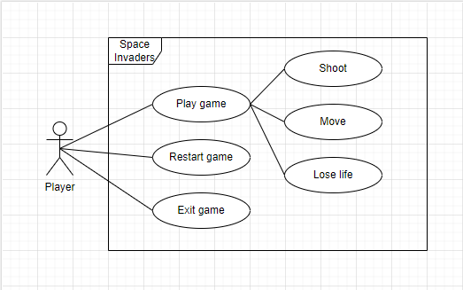

Use Case Diagram:
System users: actors
System normal situations: use-cases
A good use case must represent the point of view of the people who will use or interact with the system.
A complete set of use cases = system requirements.

Slide 3
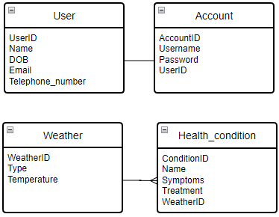
Entity Relationship Diagram (ERD):
An entity-relationship diagram illustrates interrelationships between entities in a database.
Types of relationships:
Many-to-many
One-to-many
One-to-one
An entity is a thing of interest to an organisation about which data is to be held.
An attribute is a property or characteristic of an entity.
A relationship is a link or association between entities.

Slide 4
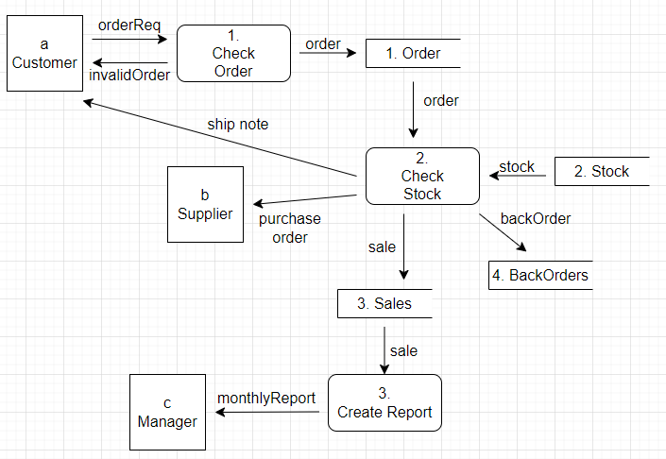
Data Flow Diagram (DFD):

Slide 5
Data Flow Diagram (DFD):
A data flow diagram is a graphical representation of how data flows through a computer system.
External entity – sharp cornered rectangles, symbol represents sources of data to the system or destinations of data from the system, people/things/organisations.
Process – rounded cornered rectangle, symbol represents an activity that transforms/manipulates the data.
Data store – opened sided rectangles, represents data that is not moving, repository of data, data can be written into the data store, data can be read from data store.
Data flow – arrow, symbol represents movement of data.

Slide 6
Data Flow Diagram (DFD):
Data can flow from
External entity to process
Process to external entity
Store to process
Process to store
Process to process
Data cannot flow from
External entity to external entity
External entity to store
Store to external entity
Store to store

Slide 7
Data dictionary:
Entity | Entity description | Attribute | Attribute description | Length | Data type | Null | Primary/ foreign key
User | This entity holds personal data about the user. | UserID | The unique identifier for the user. | 10 | Integer | False | True
 |  | Name | The name of the user. | 50 | String | True | False
 |  | DOB | The date the user was born. | 10 | Date | True | False
 |  | Email | The email belonging to the user. | 50 | String | True | False
 |  | Telephone _number | The user’s telephone number. | 50 | String | True | False
Account | This entity holds the data for the account, such as login information. | AccountID | The unique identifier for the account. | 10 | Integer | False | True
 |  | Username | The username used to log in the account. | 50 | String | True | False
 |  | Password | The password used to log in the account. | 50 | String | True | False
 |  | UserID | The unique identifier for the user. | 10 | Integer | True | True
Weather | This entity holds data about the weather. | WeatherID | The unique identifier for the weather. | 10 | Integer | False | True
 |  | Type | The type of weather that is recorded. | 50 | String | True | False
 |  | Temperature | The temperature for this type of weather. | 5 | Double | True | False
Health_condition | This entity holds data about health conditions. | ConditionID | The unique identifier for the health condition. | 10 | Integer | False | True
 |  | Name | The name of the health condition. | 50 | String | True | False
 |  | Symptoms | The symptoms of the health condition. | 255 | String | True | False
 |  | Treatment | The treatment of the health condition. | 255 | String | True | False
 |  | WeatherID | The unique identifier of the weather. | 10 | Integer | True | True

Slide 8
Data dictionary:
Data dictionaries store all of the entity name used in the system.
Detailed description of entities, relationships and attributes should be included.
Columns:
Entity
Entity description
Attribute
Attribute description
Length
Data type
Validation
Null
Primary/foreign key

Slide 9
Data dictionary:
Data types:
Text/string – a sequence of characters. E.G. Text!
Alphanumeric – a combination of letters and numbers. E.G. SW1A 2AA
Date/time – expressing a date and/or a time. E.G. 01/03/24 12:34
Integer – a whole number. E.G. 33.
Real – a decimal number. E.G. 101.23
Boolean – a value that can only be true or false (can be represented by something else). E.G. 1 or 0
Validation:
Check digit – the last one or two digits in a code are used to check other digits are correct.
Format check – checks the data is in the right format.
Length check – checks the data isn’t too short or too long.
Lookup table – looks up acceptable values in a table.
Presence check – checks that data has been entered into a field.
Range check – checks that a value falls within the specified range.
Spell check – looks up words in a dictionary.

